Slide 1
UI Status
Matt Hollingsworth

Slide 2
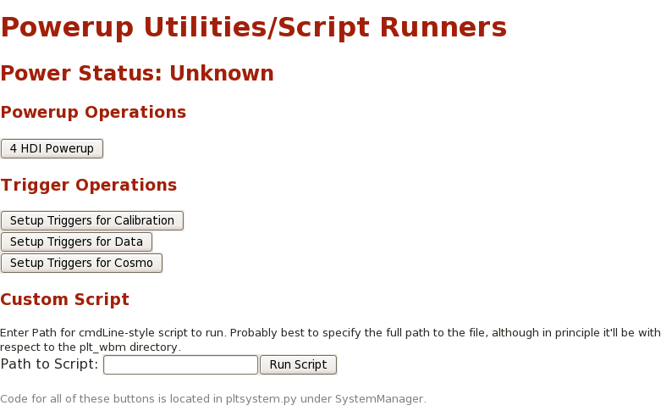
Powerup Procedure

Slide 3
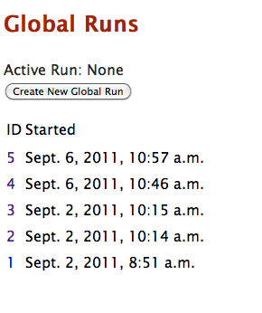
Workflow
Create Global Run
Power up (initialize)
Run Calibrations
Do data runs

Slide 4
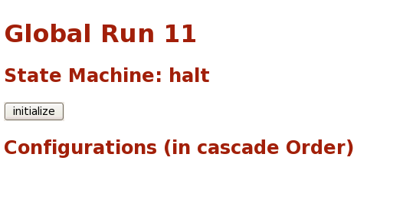
Initialize
Run starts off halted
Clicking initialize runs the equivalent of 4hdi powerup

Slide 5
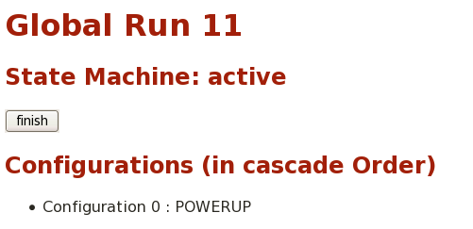
Ready to Calibrate
After initialized, a powerup (seed) config is created
Each time a calibration or script is run, the list of configurations will grow will grow
The final config is a cascade (in order) of all of these config

Slide 6
Summary
Testing powerup procedure using web UI sometime soon would be nice
Docs are here: https://twiki.cern.ch/twiki/bin/view/CMS/PLTUI

